Slide 1
Introduction to Linux
Suraj Uppalapati

Slide 2

What is Linux?
Open Source OS
Kernel
Ubuntu

Slide 3
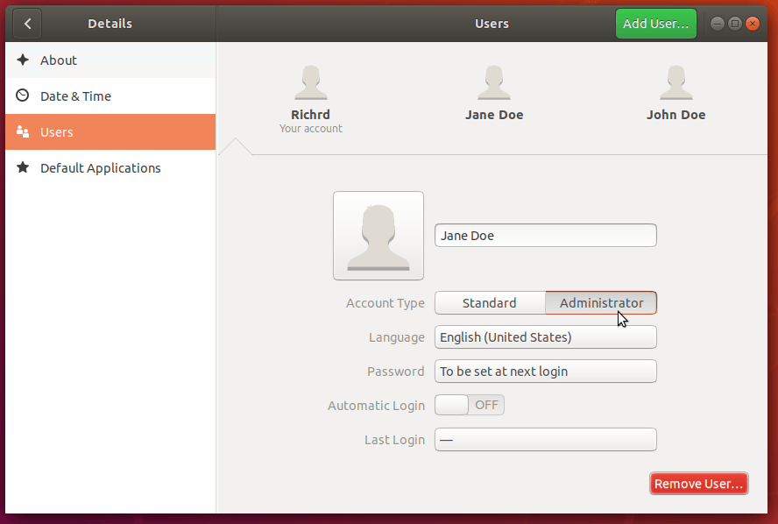
Users
Root
Full administrative access
Requires authentication
Regular
Limited access
Password
12+ characters (numbers, letters, special characters)
CyberPatriot!234

Slide 4
User Groups
Primary
Automatically created with user
Created files belong to this group
Secondary
Not required
Access to new resources
Can be in any number of groups
Command: usermod -aG sudo newuser

Slide 5
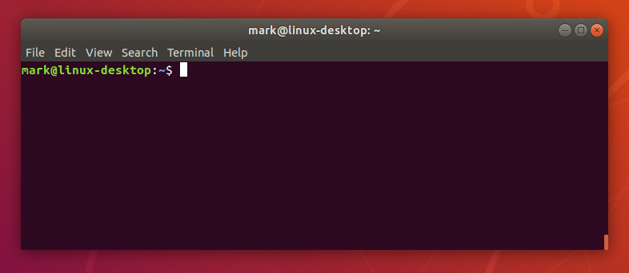
Terminal
Used for system maintenance/administration
How to use
Type command
Enter
Ctrl-C to abort

Slide 6
Basic Commands
ls - list files in directory
ls documents
cd - change directory
cd documents
cp - copy files or directories
cp file.txt file2.txt
nano - edit or make files
nano file.txt
pwd - print working directory
pwd
https://ubuntu.com/tutorials/command-line-for-beginners#1-overview

Slide 7
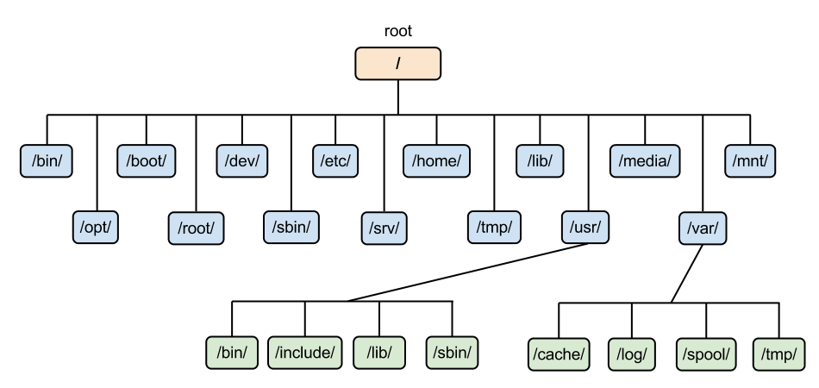
File Structure
Hierarchical tree
Absolute path
/usr/bin/test
Relative path
bin/test
Special directories (. & ..)

Slide 8

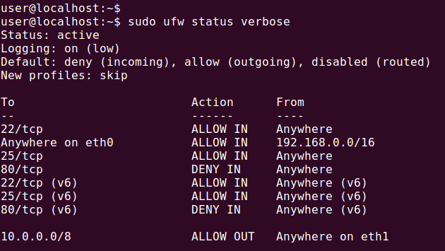
Firewall
Monitors and filters incoming and outgoing network traffic
Commands
ufw status
ufw enable
ufw default deny incoming
ufw default allow outgoing
ufw allow [out] PORT

Slide 9

Software Updates
sudo apt-get update && sudo apt-get upgrade
Software Updater
sudo apt-get autoremove

Slide 10
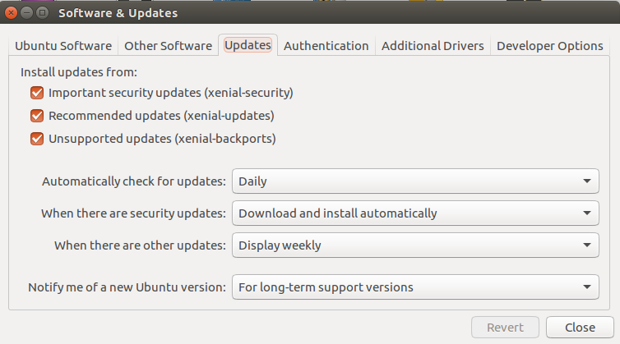
Automatic Updates
Install updates from: ALL
Automatically check for updates: Daily
When there are security updates: Download and install automatically
When there are other updates: Display weekly
Notify me of a new Ubuntu version: For long-term support versions

Slide 11
Daily Forensic Questions
List the names of the secondary groups john is in
Who is the owner of passwordlist.txt

Slide 12
Answers
Answer:
groups john
Answer:
find ~/ -type f -name passwordlist.txt
ls -l passwordlist.txt

